Slide 1
ELNG 406 – POWER SYSTEM PLANNING AND OPTIMIZATION
UNIT COMMINTMENT
K. A. KYEREMEH

Slide 2
INTRODUCTION
Since generators cannot instantly turn on and produce power, unit commitment (UC) must be planned in advance so that enough generation is always available to handle system demand with an adequate reserve margin in the event that generators or transmission lines go out or load demand increases.

Slide 3
INTRODUCTION
Unit commitment handles the unit generation schedule in a power system for minimizing operating cost and satisfying prevailing constraints such as load demand and system reserve requirements over a set of time periods
The classic UC problem is aimed at determining the start - up and shutdown schedules of thermal units to meet forecasted demand over certain time periods (24 h to 1 week) and belongs to a class of combinatorial optimization problems.

Slide 4
METHODS FOR SOLVING UC
The methods that have been studied so far fall into roughly three categories: heuristic search, mathematical programming, and hybrid methods.
Optimization techniques such as the priority list, augmented Lagrangian relaxation, dynamic programming, and the branch – and – bound algorithm have been used to solve the classic UC problem.
Genetic algorithms (GA), simulated annealing (SA), analytic hierarchy process (AHP), and particle swarm optimization (PSO) have also been used for UC problem since the beginning of the last decade.

Slide 5
pRIORITY METHOD
The classic UC problem is to minimize total operational cost and is subject to minimum up - and downtime constraints, crew constraints, unit capability limits, generation constraints, and reserve constraints.
Thus the objective function of UC consists of the generation cost function and start - up cost function of the generators
There are two types of start – up cost model: one is bringing the unit online from a cold start and the other is bringing it from bank status, in which the unit is turned off but still close to operating temperature.

Slide 6
PRIORITY MEHTOD
The start – up cost model when cooling can be expressed in the exponential function below:

Slide 7
Priority method
The start - up cost model when banking can be expressed as a linear function as below:

Slide 8
Priority method
The simplest unit commitment solution is to list all combinations of units on and off, as well as the corresponding total cost to create a rank list, and then make the decision according to the rank table.
This method is called the priority list. The rank is based on the minimum average production cost of the unit. The average production cost of the unit is defined as

Slide 9
Priority method
The incremental rate of the unit is defined as

Slide 10
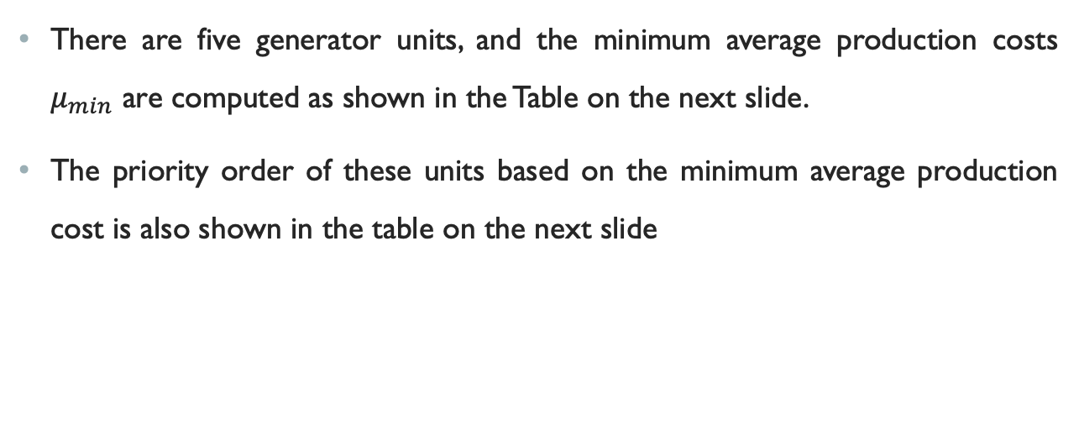
Example 1
There are five generator units, and the minimum average production costs $μ_{min}$ are computed as shown in the Table on the next slide.
The priority order of these units based on the minimum average production cost is also shown in the table on the next slide

Slide 11
Example 1

Slide 12
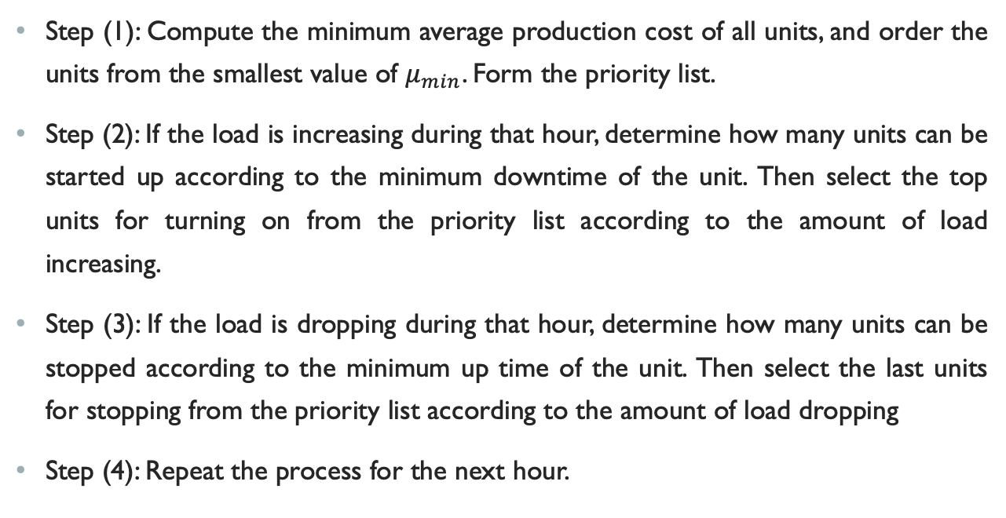
solution
Step (1): Compute the minimum average production cost of all units, and order the units from the smallest value of $μ_{min}$. Form the priority list.
Step (2): If the load is increasing during that hour, determine how many units can be started up according to the minimum downtime of the unit. Then select the top units for turning on from the priority list according to the amount of load increasing.
Step (3): If the load is dropping during that hour, determine how many units can be stopped according to the minimum up time of the unit. Then select the last units for stopping from the priority list according to the amount of load dropping
Step (4): Repeat the process for the next hour.

Slide 13
Example 2
Use priority list method to solve the unit commitment for a simple four – unit system. The data of the units and the load pattern are listed in the Tables in the next slide.
the symbol “ − ” in the initial state means the unit is offline. For example, “ 8 ” means the unit has been online for 8 hours, and “ − 6 ” means the unit has been offline for 6 hours

Slide 14
Example 2

Slide 15
Solution
The ordering of the unit combinations

Slide 16
solution
Neglecting the constraints of unit minimum up/down time. Solve UC problem using the priority list order.
In case 1, units are committed in order until the load is satisfied.
The total cost for the interval is the sum of the eight dispatch costs plus the transitional costs for starting any units.
It can be known from the average production cost in the Table on slide 14 that the priority order for the four units is unit 3, unit 2, unit 1, unit 4.

Slide 17
solution
All possible commitments start from state 12 since the load at first hour is 450 MW, and maximum net capacity from state 1 to state 11 is only 440 MW.
In addition, state 13 is discarded since it does not satisfy the order of the priority list.
The UC results for the priority ordered method are listed in the Table on the next slide .

Slide 18
Uc results by priority list

